Slide 1
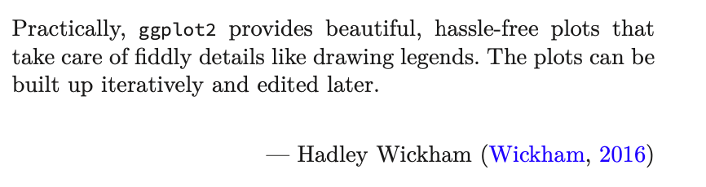
Data Science for Operational Researchers using R
05 – ggplot2
https://github.com/JimDuggan/Data-Science-for-OR

Slide 2
Course Overview
Topic | Description
 | Morning 1
1 | Introduction to R and Posit Cloud
2 | Atomic Vectors
3 | Functions, Lists and Functionals
4 | Data Frames and Tibble
5 | ggplot2
 | Morning 2
6 | Data transformation with dplyr
7 | Relational Data with dplyr
8 | OR Example 1 – Exploratory Data Analysis
9 | OR Example 2 – System Dynamics

Slide 3
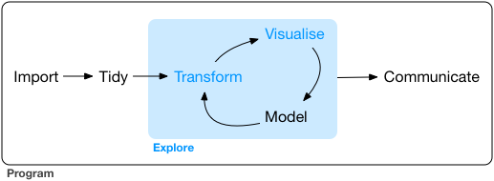
Exploratory Data Aanalysis: Goal
Develop an understanding of your data
Use questions as tools to guide your investigation
A creative process “the key to asking quality questions is to generate a large quantity of questions”
Useful to explore variation in variables
“Data exploration is the art of looking at your data, rapidly generating hypotheses, quickly testing them, then repeating again and again and again.” (Wickham and Grolemund 2017).

Slide 4
Defining Important Terms (Wickham and Grolemund)
Term | Explanation
Variable | A quantity, quality or property that you can measure
Value | The state of a variable when you measure it. The value of a variable may change from measurement to measurement
Observation (or case) | A set of measurements made under similar conditions (you usually make all of the measurements in an observation at the same time and on the same object). An observation will contain several values, each associated with a different variable.
Tabular data | A set of values, each associated with a variable and an observation. Tabular data is tidy if each value is placed in its own “cell”, each variable in its own column, and each observation in its own row. All the data in aimsir17 and ggplot2 is tidy data.

Slide 5
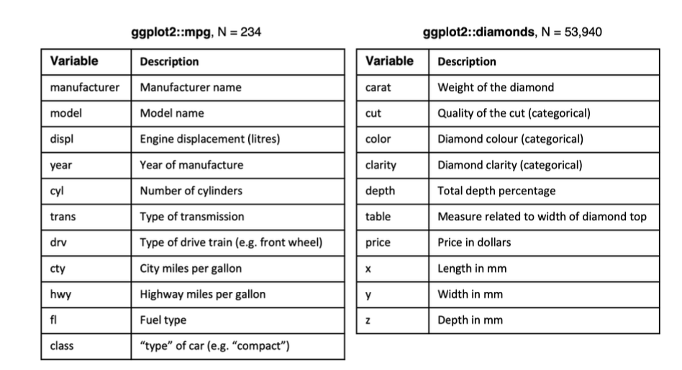
ggplot2
Layered grammar of graphics, enables us to concisely describe the components of a graphic.
Benefits:
plots can be designed in a layered manner (+ operator)
a wide range of plots can be generated to support decision analysis, including scatterplots, histograms and time series charts
charts can be developed rapidly, and this support an iterative process of decision support

Slide 6
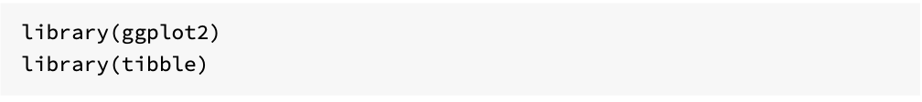
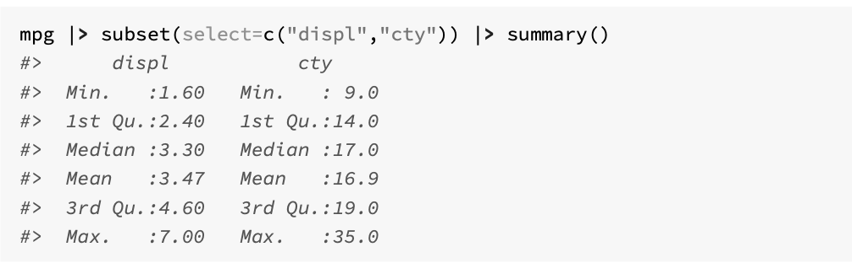
Exploring a tibble

Slide 7
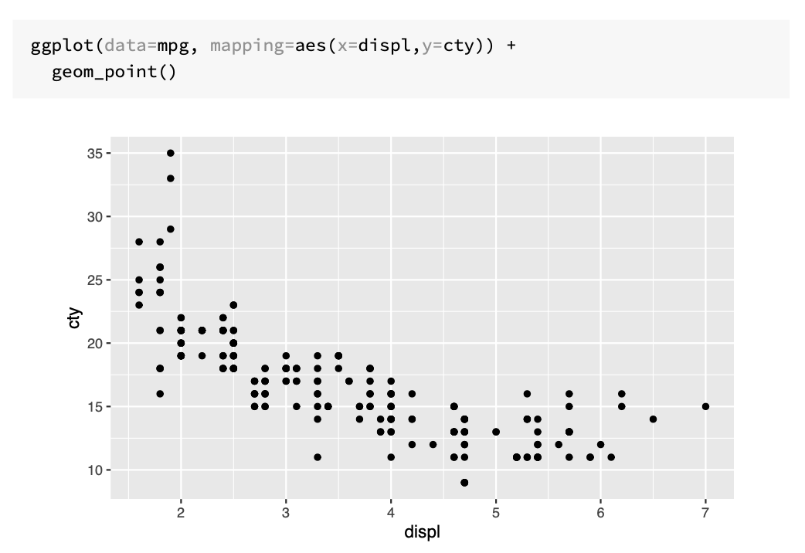
Visualising: data + mapping + geometric object

Slide 8
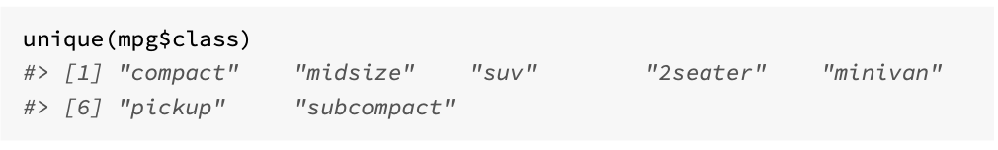
Exploring additional mappings
Seven classes of car…

Slide 9
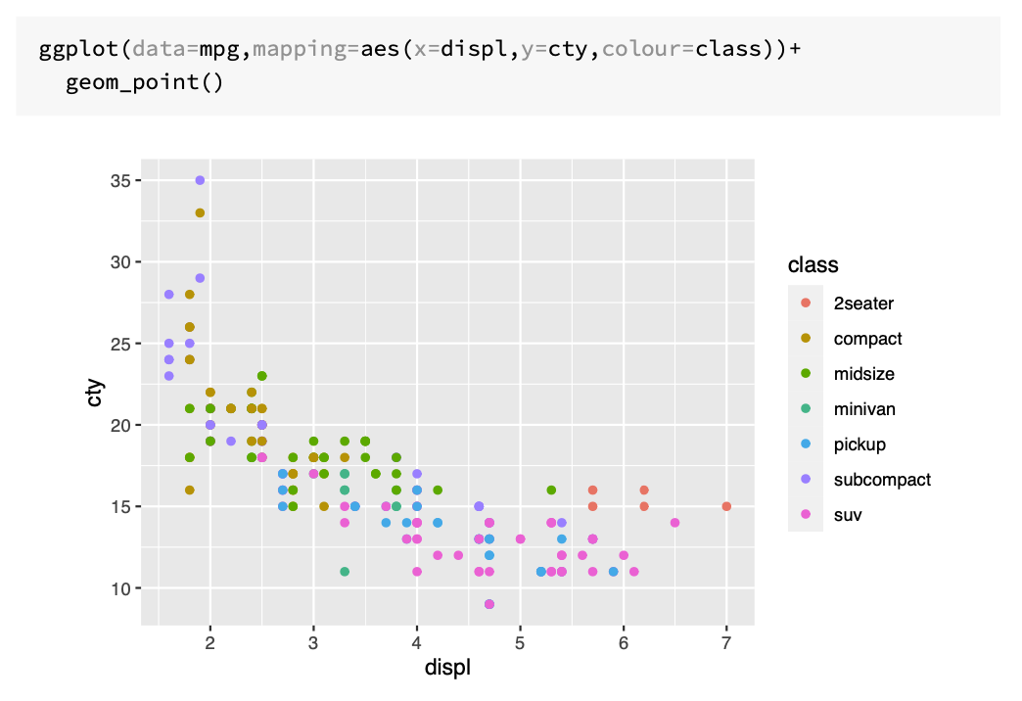

Slide 10
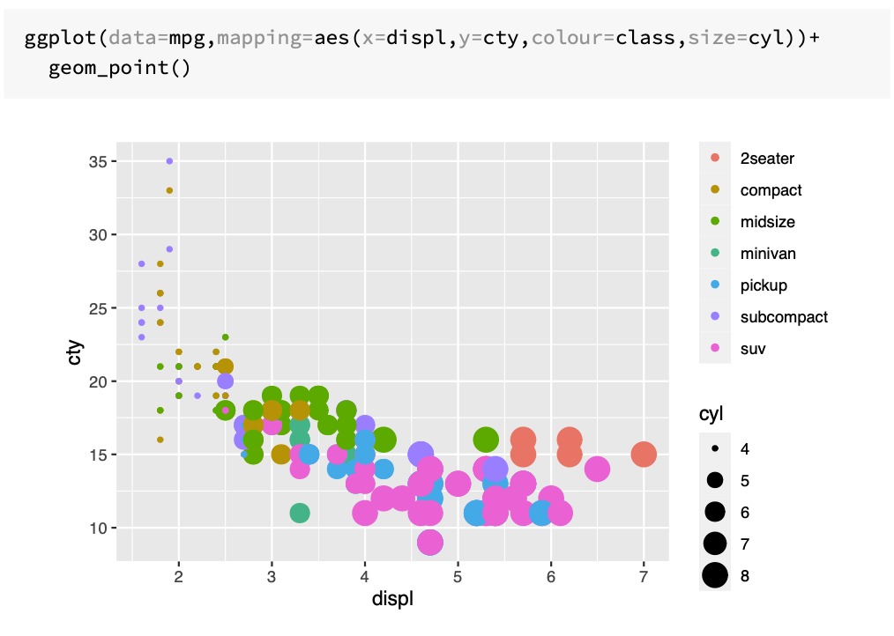

Slide 11
Customising Plot Appearance with lab()
Argument | Role
title | provides an overall title text for the plot
subtitle | adds a subtitle text
colour | allows you to specify the legend name for the colour attribute
caption | inserts text on the lower right hand side of your plot
size | allows you to name the size attribute
x | name the x-axis
y | name the y-axis
tag | text for tag label for top-left of plot

Slide 12
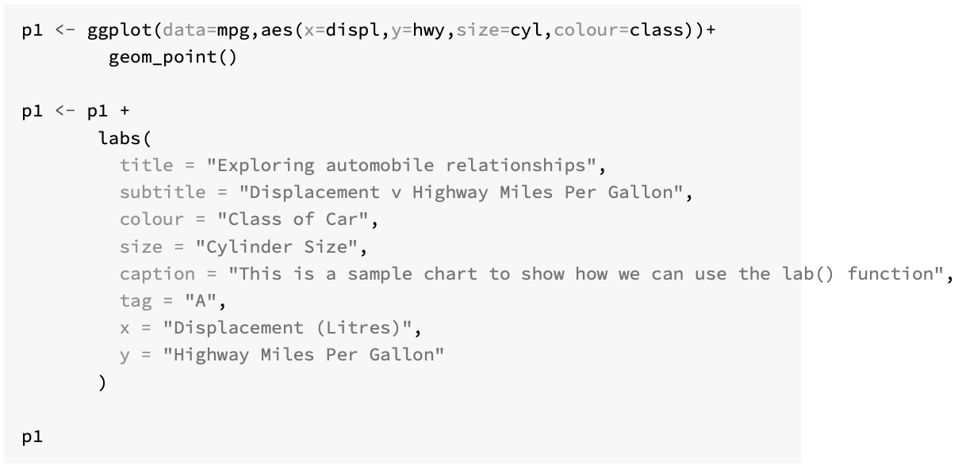

Slide 13
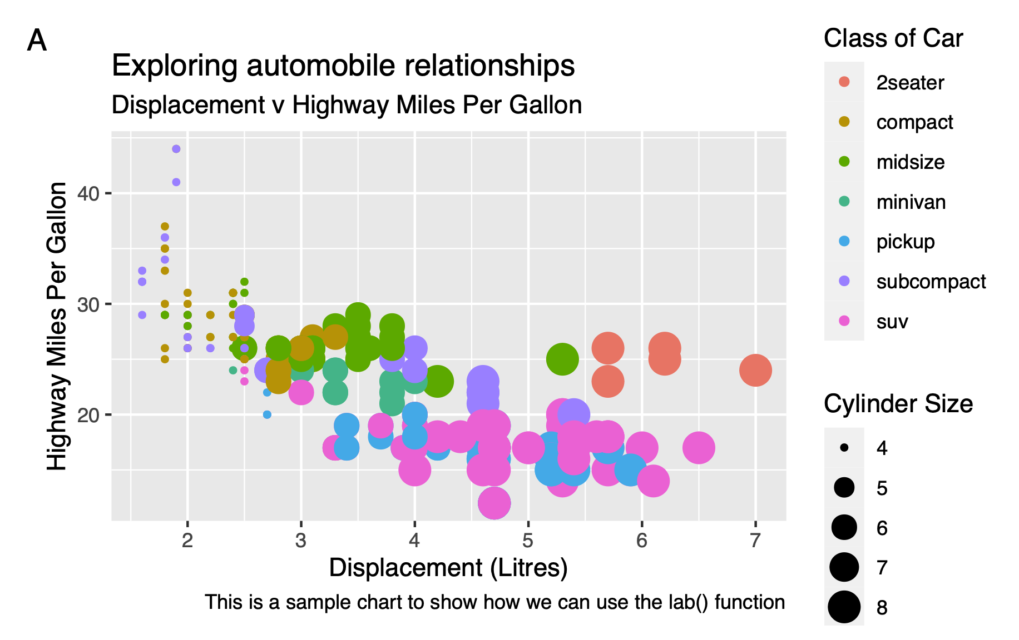

Slide 14
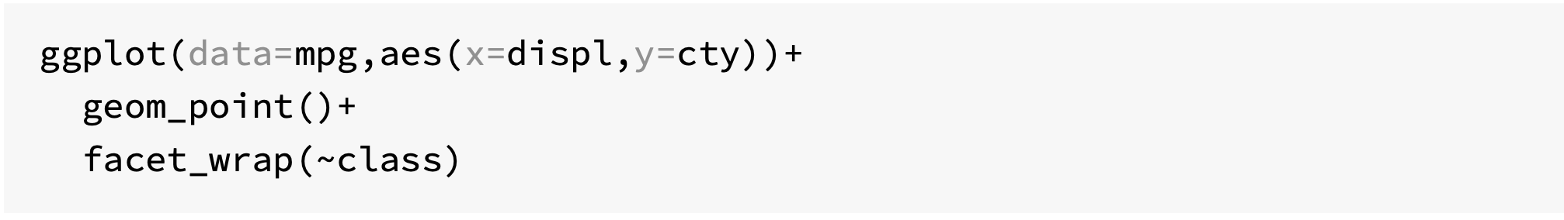
Subplots with Facets

Slide 15
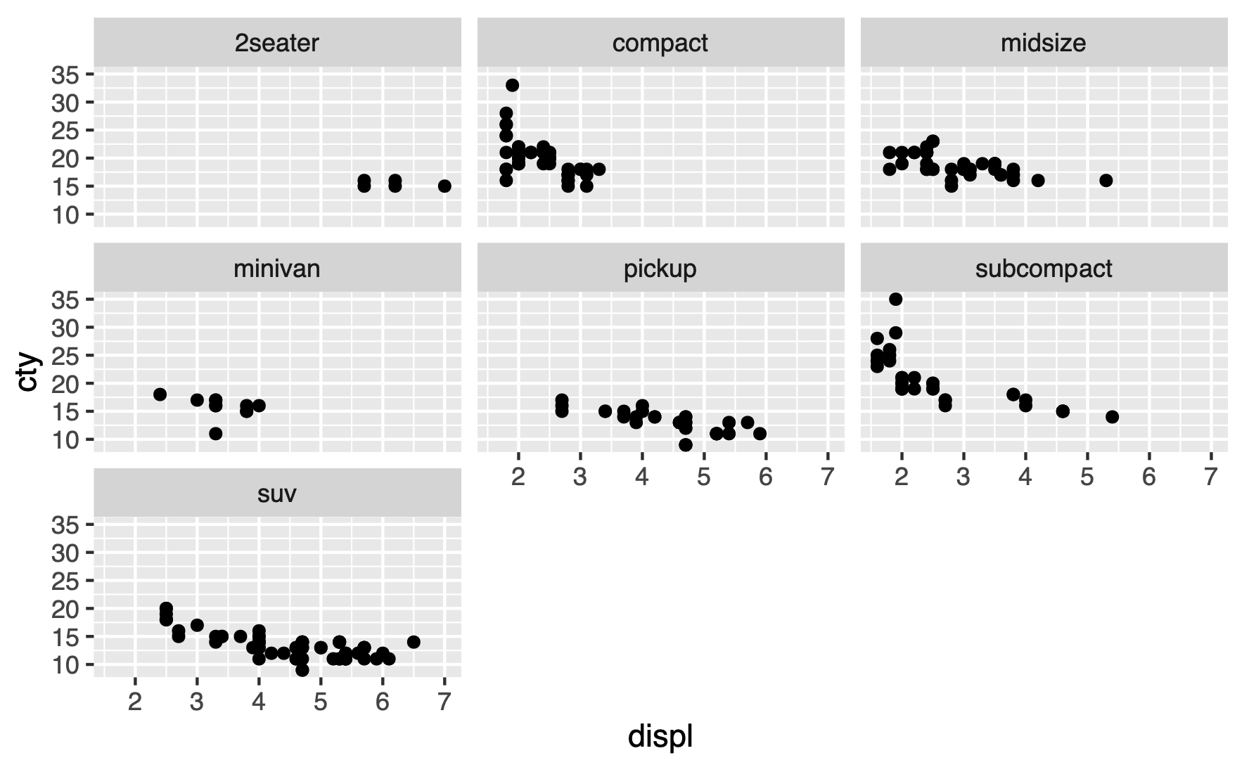

Slide 16
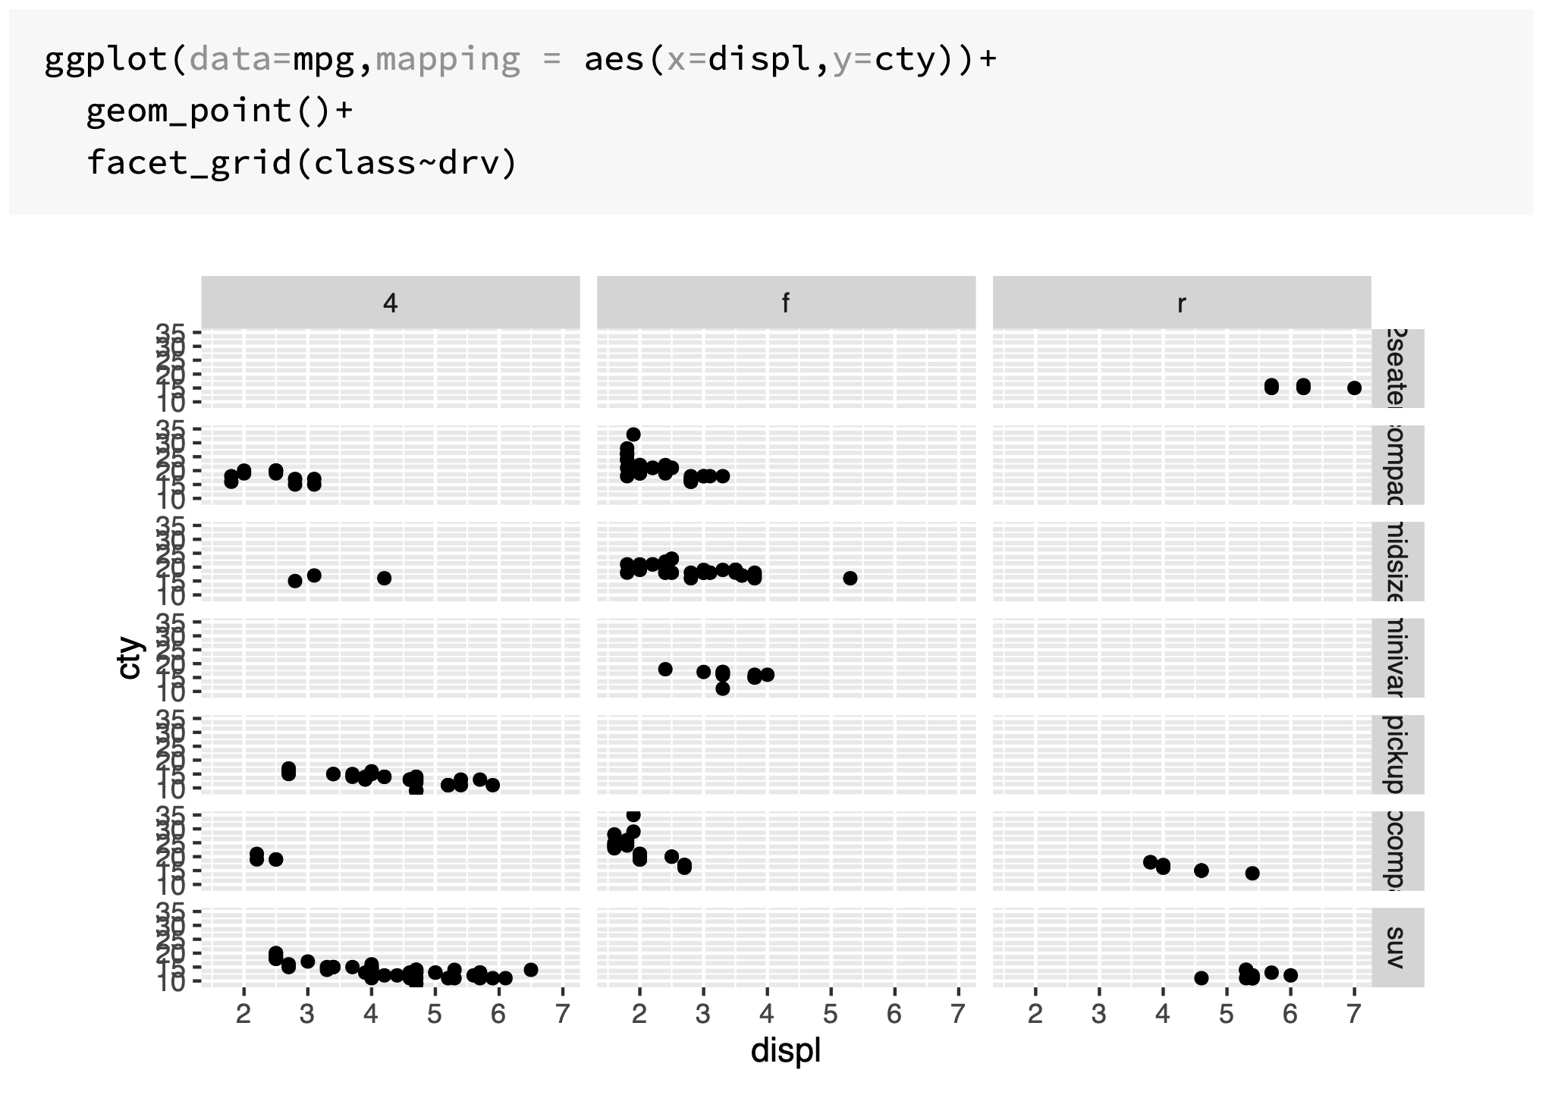

Slide 17
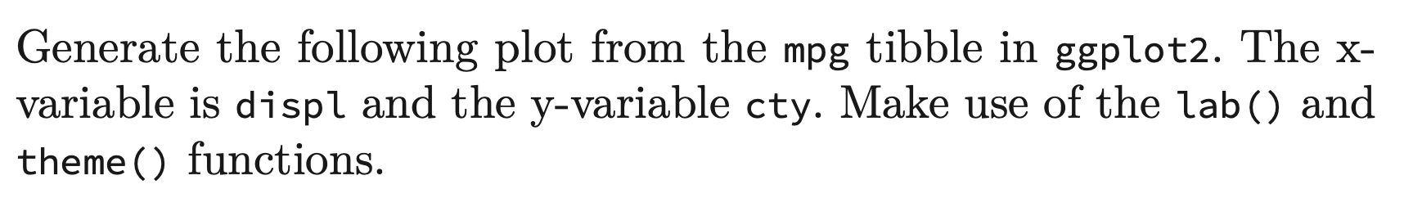
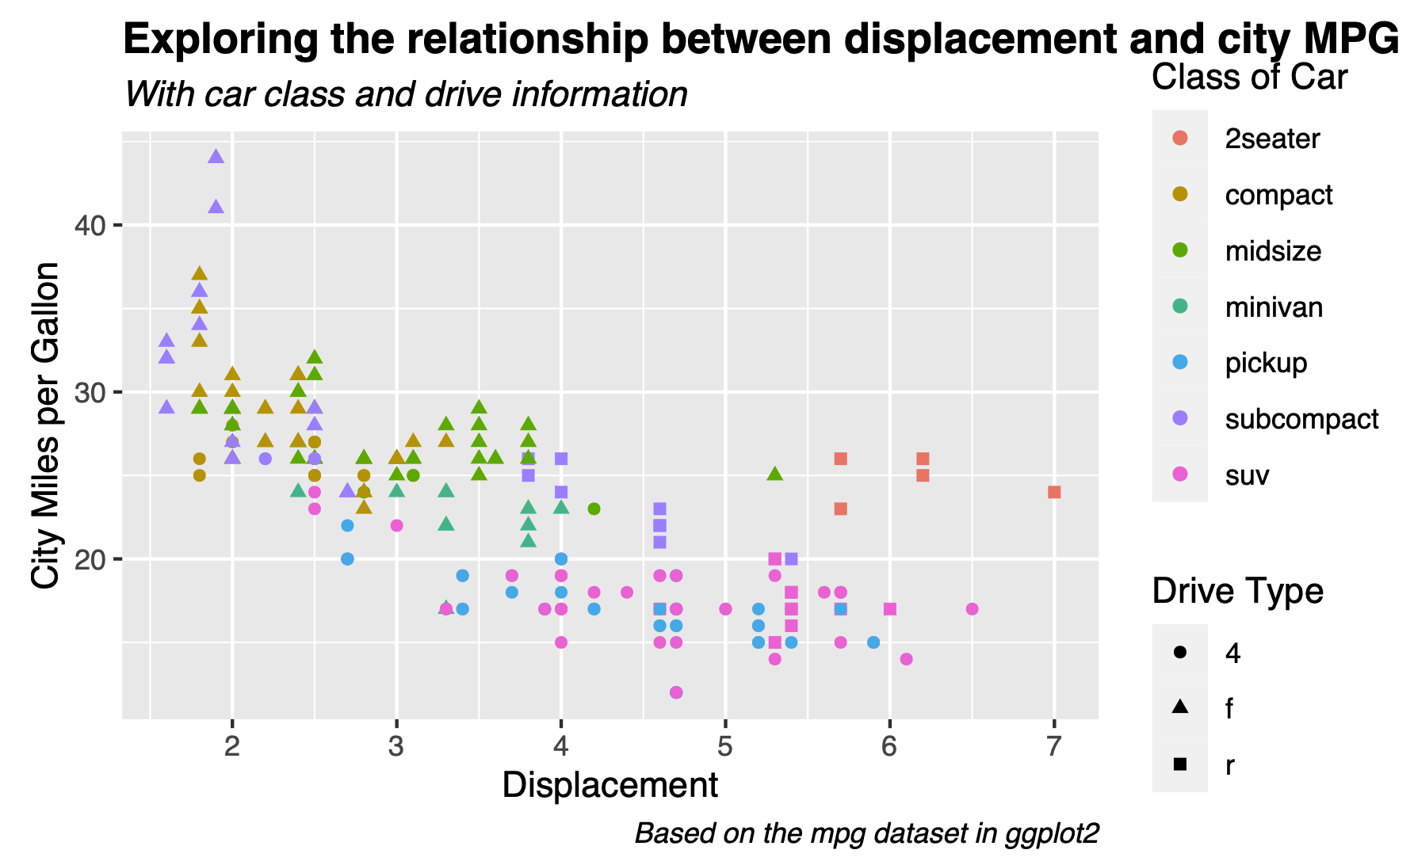
Challenge 5.1

Slide 18
Statistical Transformations
Many graphs, like scatterplots, plot the raw values of the dataset
However, other graphs (e.g. bar charts) calculate new values to plot
Bar charts, histograms and frequency polygons bin your data and plot bin counts, the number of points that fall in each bin
Smoothers fit a model to your data and the plot predictions from the model
Boxplots compute a robust summary of the distribution and display a specially formatted box

Slide 19
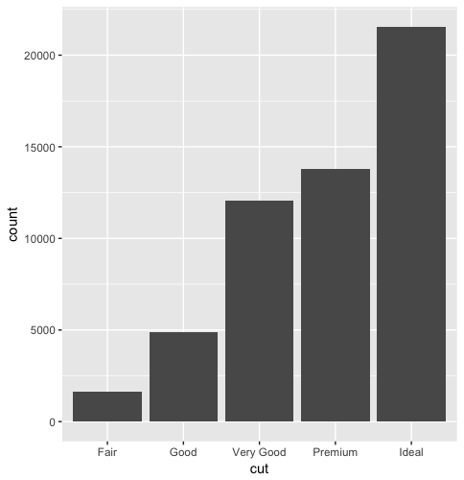
Variation
Bar Chart of Diamonds Data
Variation is the tendency of the values of a variable to change from measurement to measurement
If you measure a continuous variable twice, you can get two different results
For example, temperature at 12.00 and temperature at 13.00
Very variable has its own pattern of variation
The best way to understand the pattern is to visualize the distribution of a variable’s values.

Slide 20
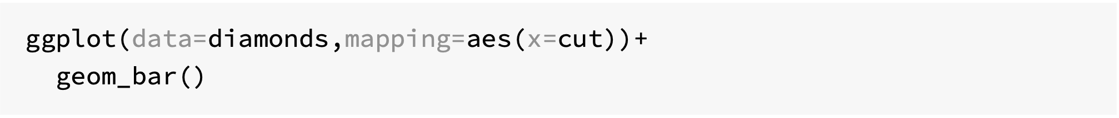
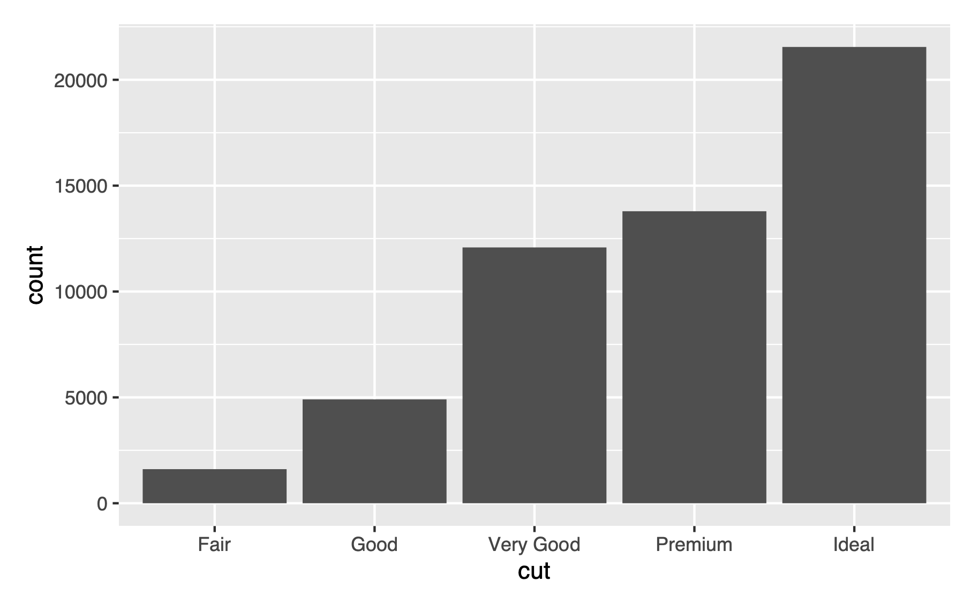

Slide 21
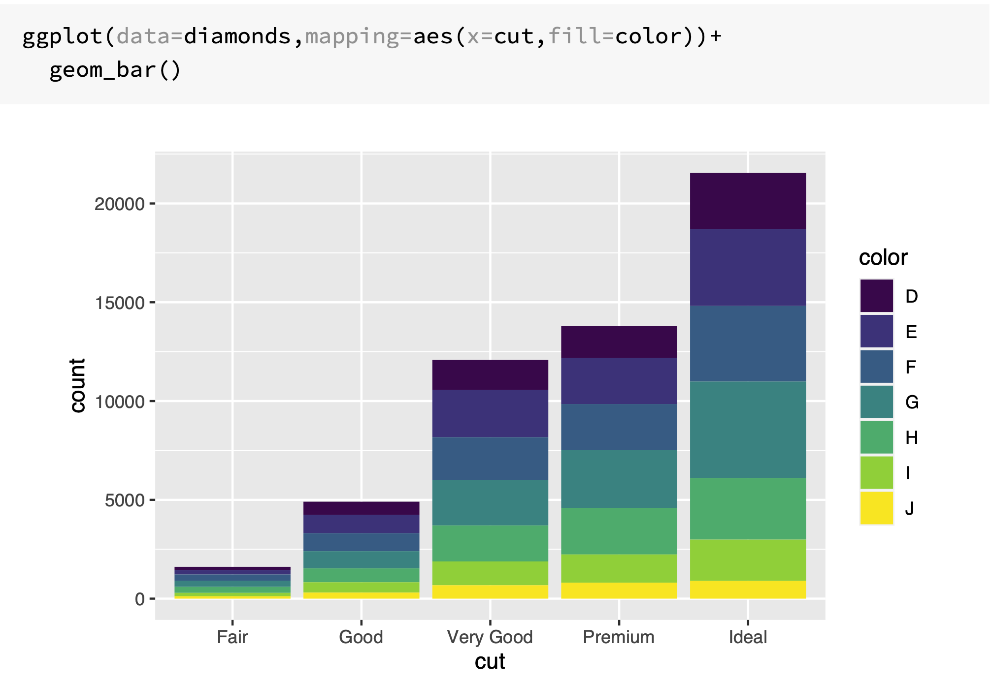

Slide 22
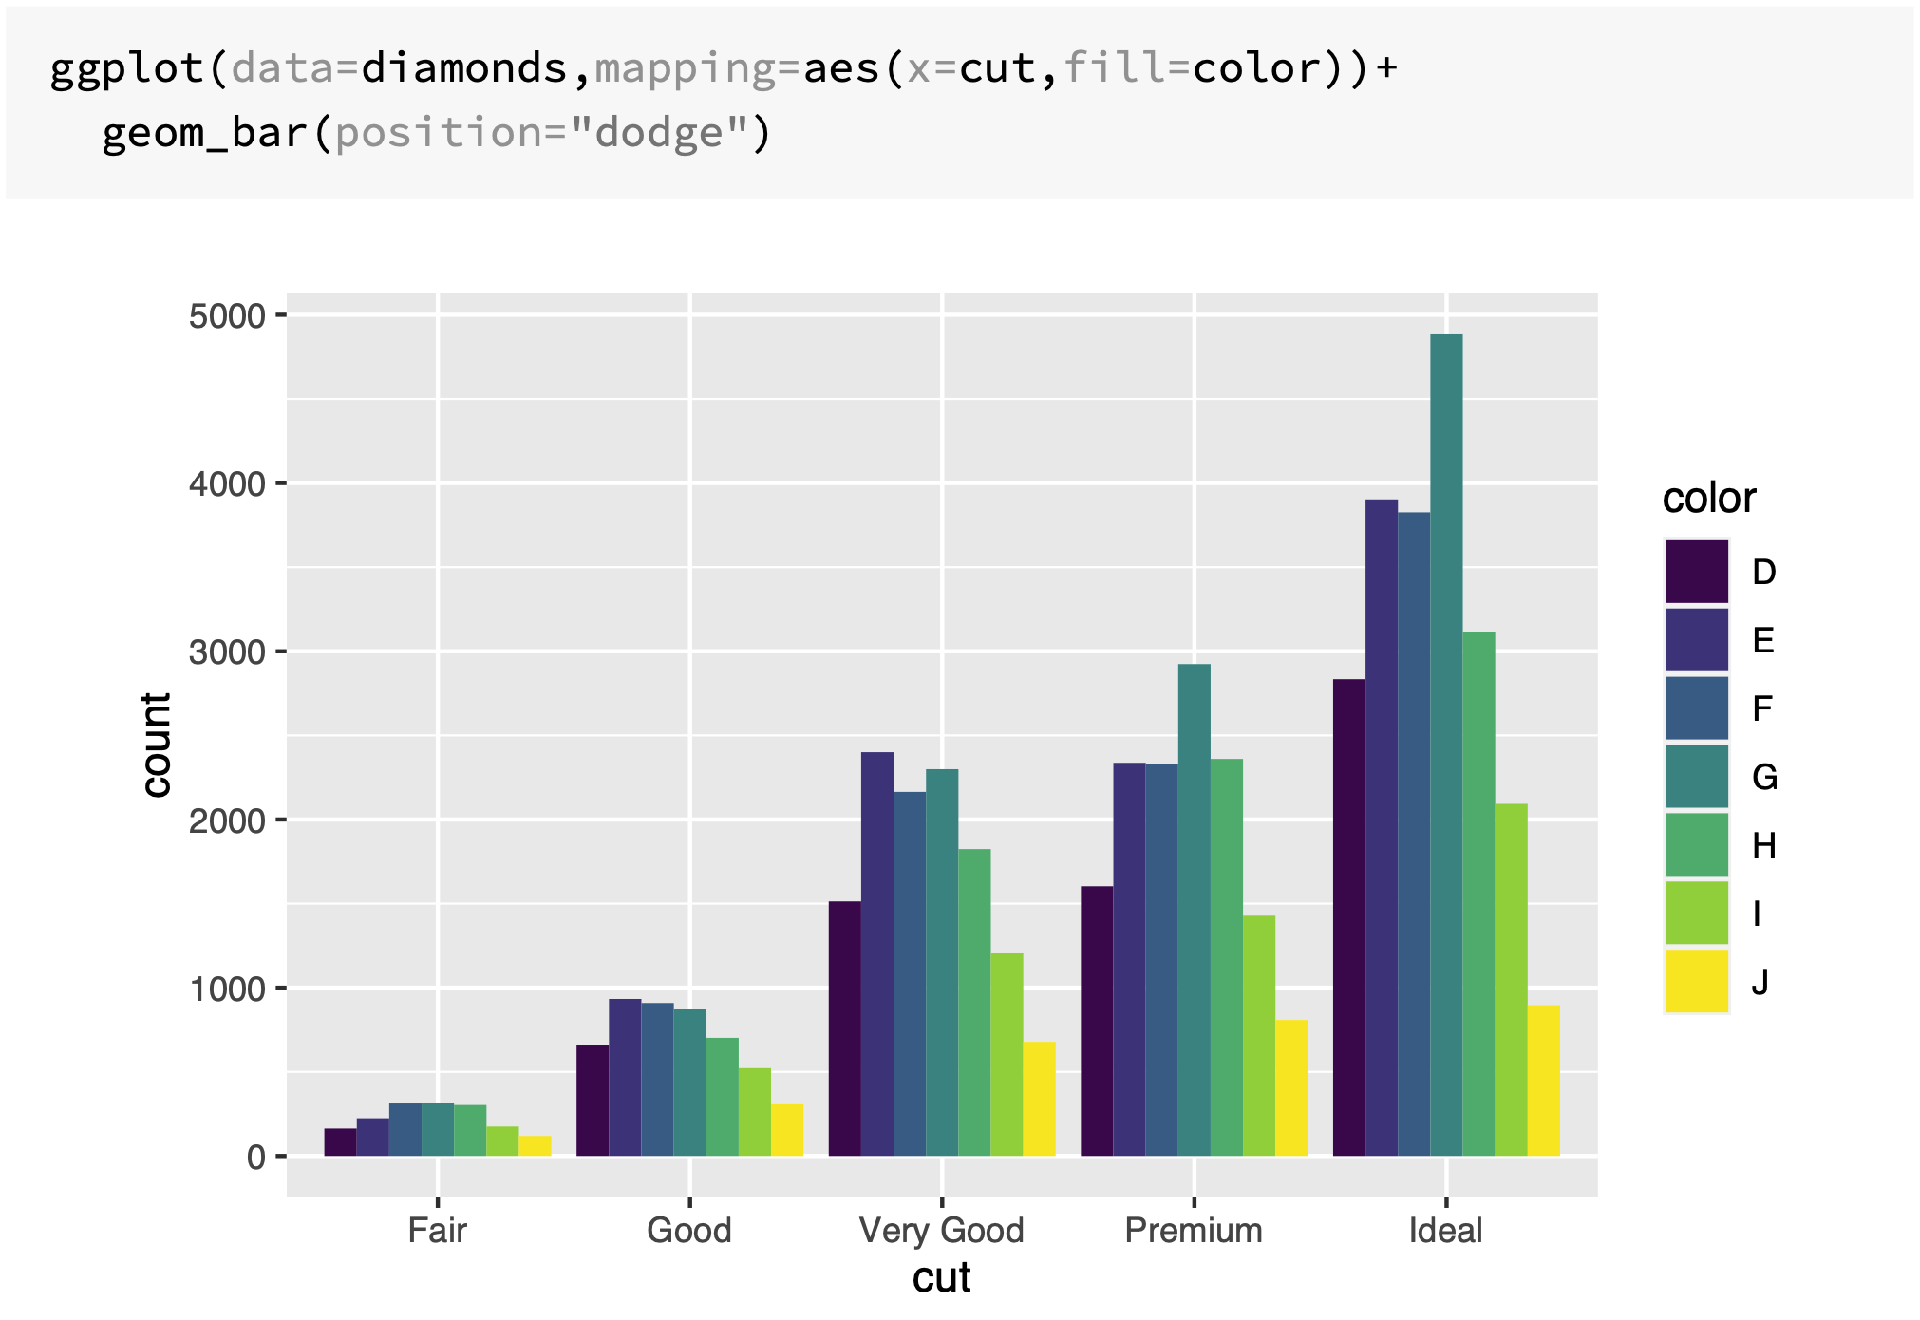

Slide 23
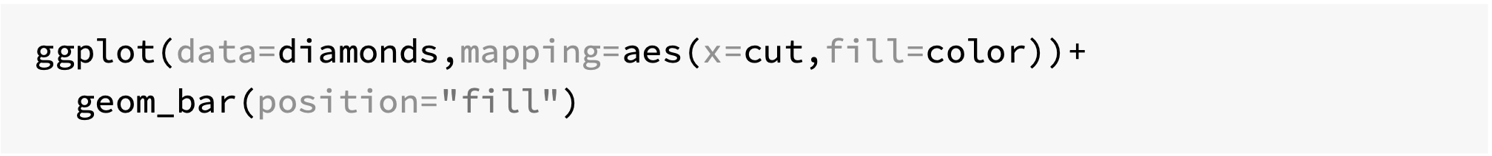
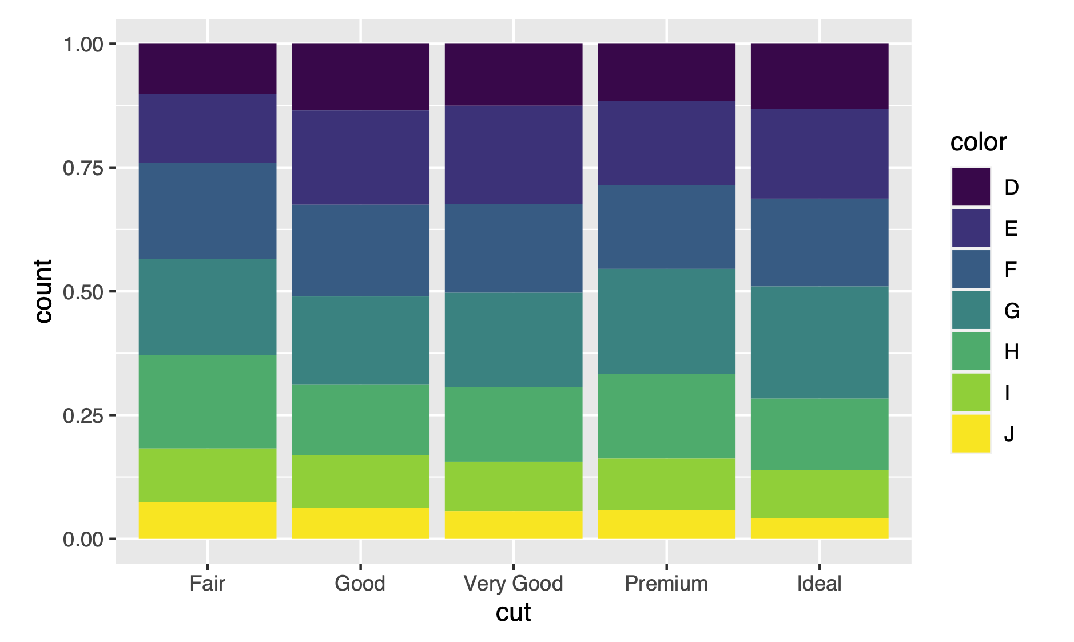

Slide 24
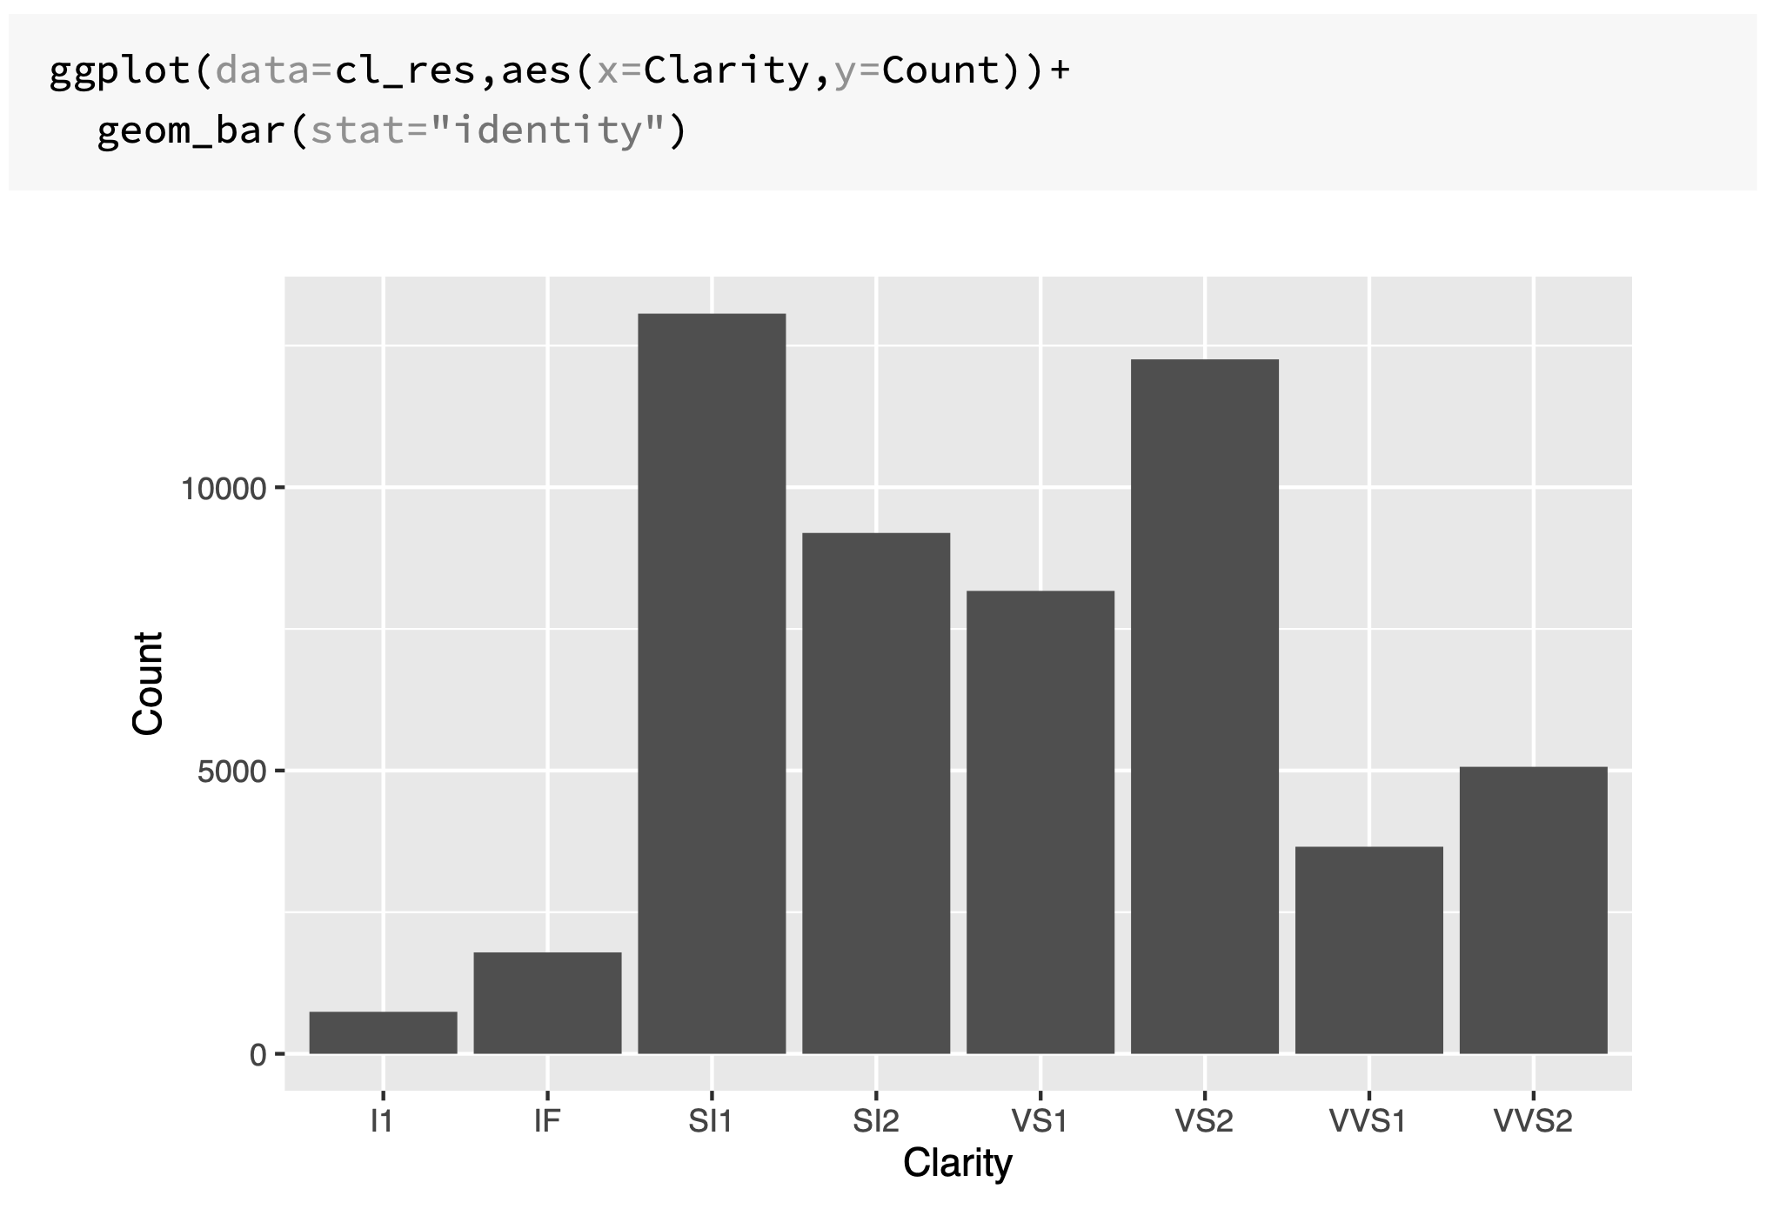
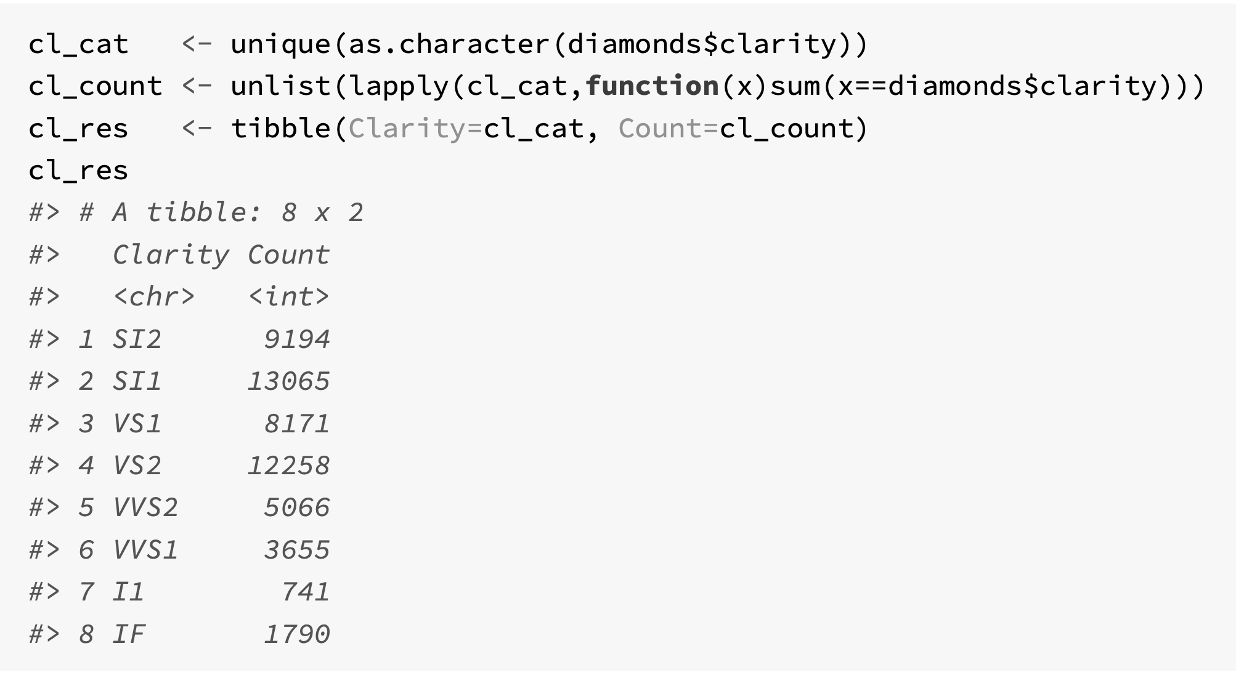
Bar chart without transformations

Slide 25
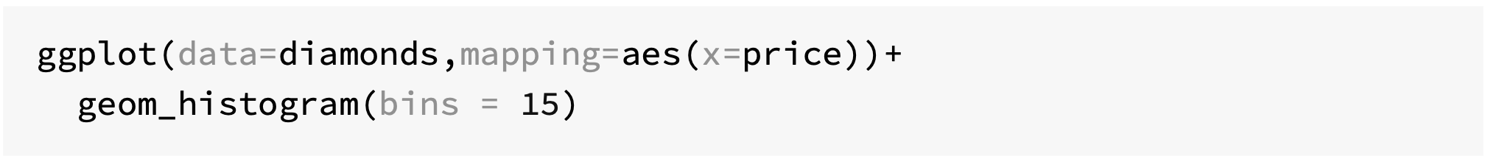
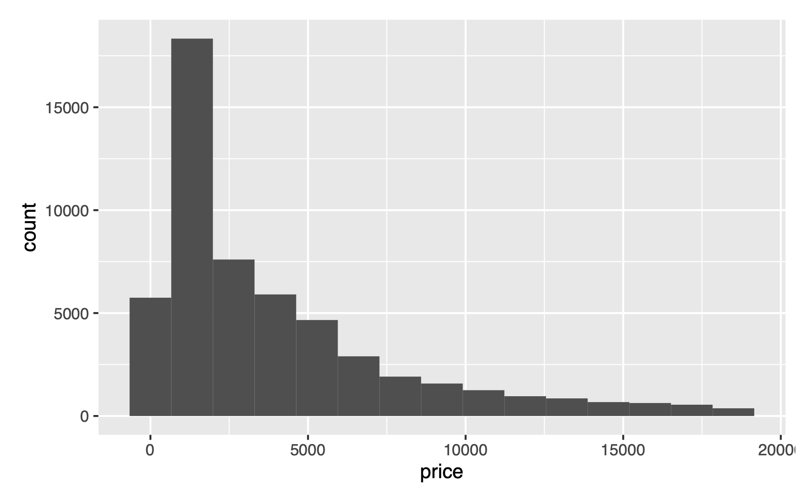
Visualising distributions (continuous variable)

Slide 26
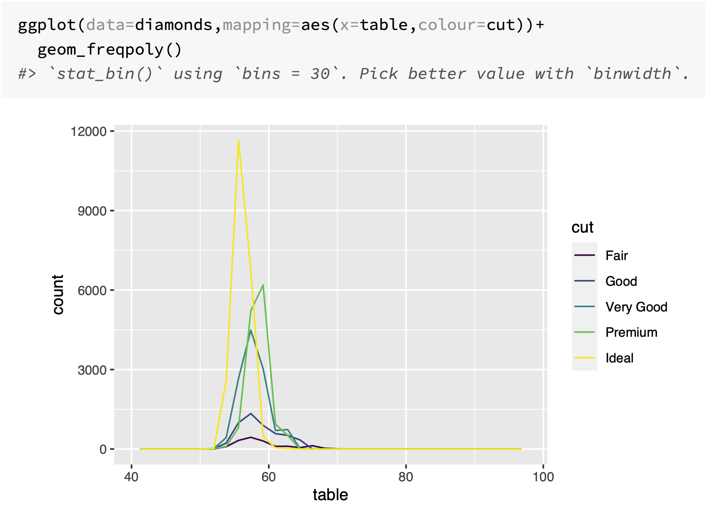

Slide 27
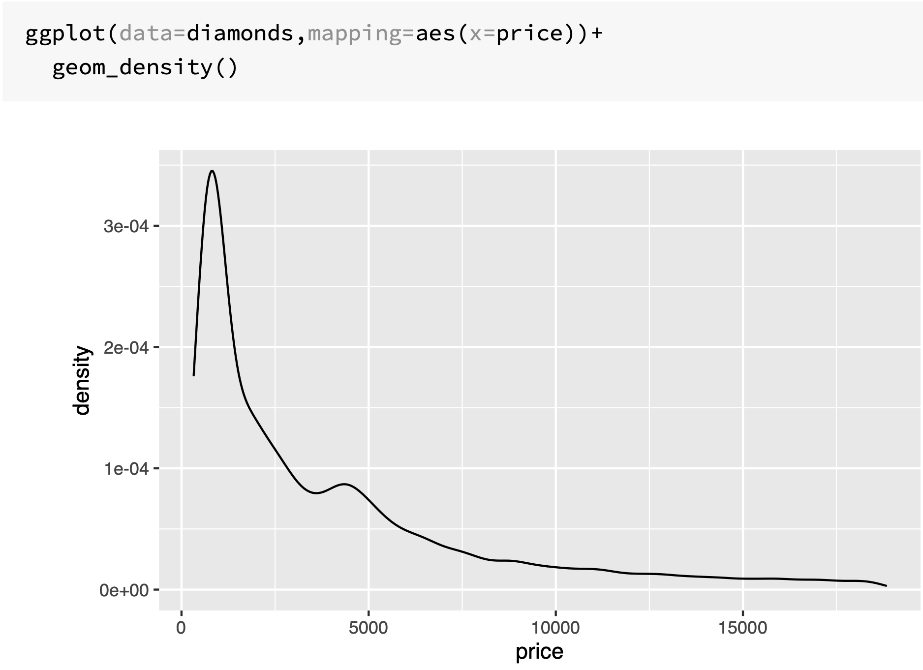
Kernel density estimates

Slide 28
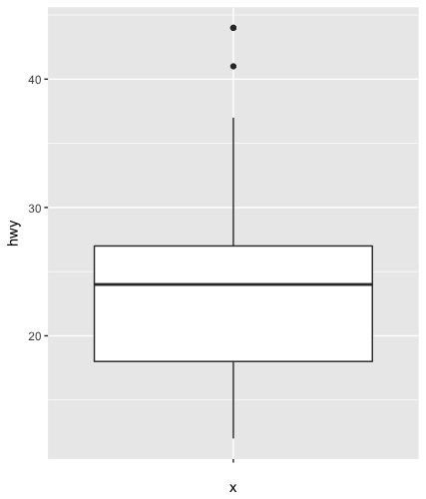
Boxplot
Display the distribution of a continuous variable broken down by a categorical variable
Box that stretches from the 25th to 75th percentile a distance known as the interquartile range (IRQ)
Median in the middle of box
Points outside more that 1.5 times the IQR from either edge of the box are displayed (outliers)
Whisker extends to the farthest non-outlier point in the distribution

Slide 29
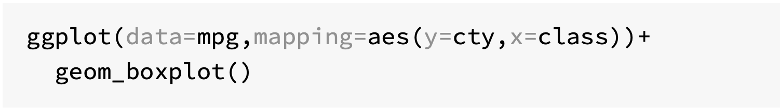
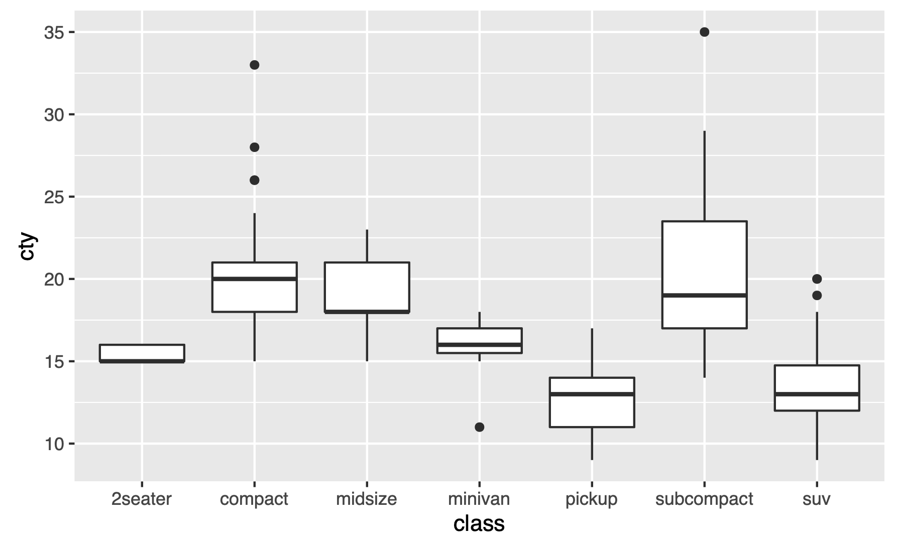

Slide 30
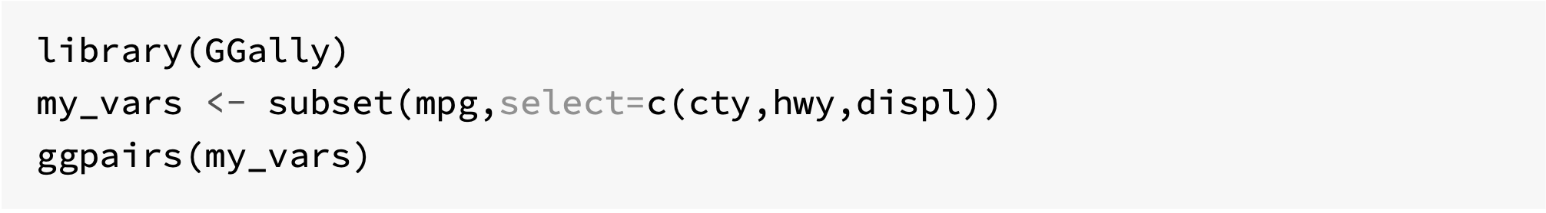
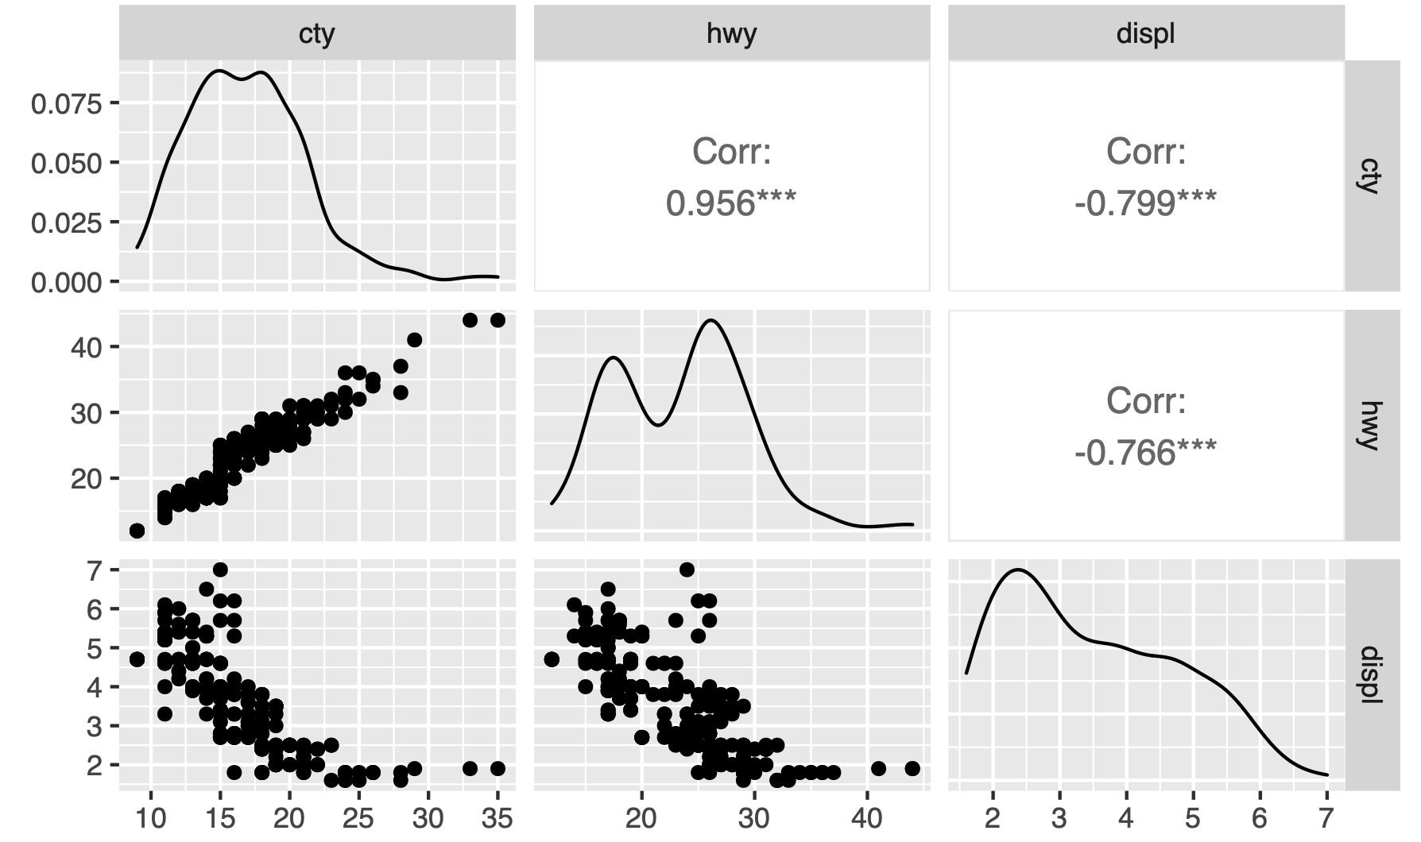
Covariation with ggpairs()

Slide 31
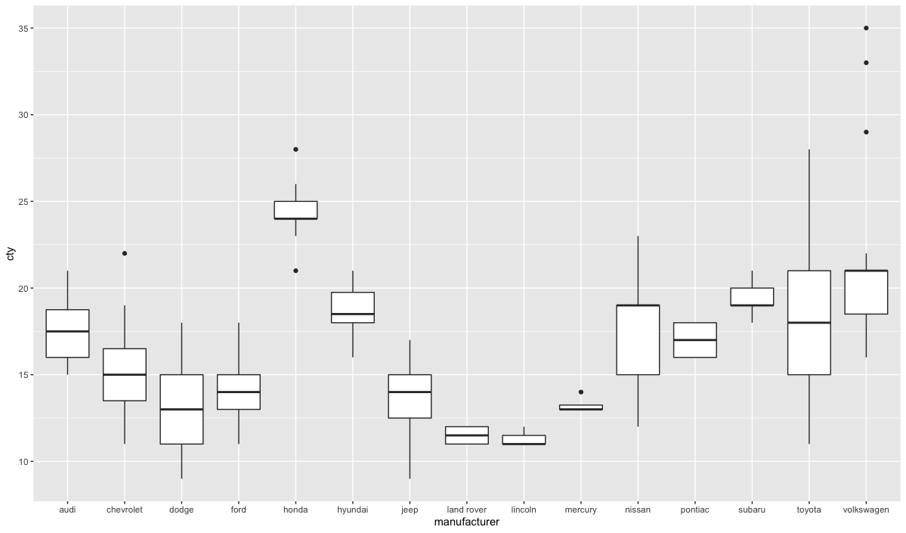
Challenge 5.2
Generate the following boxplot from mpg

Slide 32
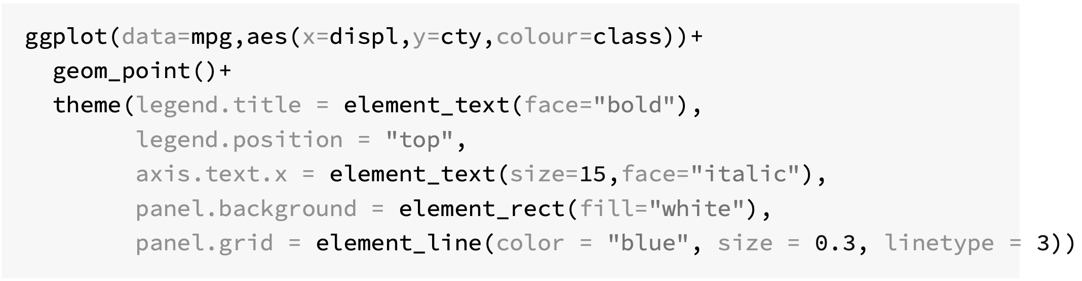
Themes in ggplot2
The theme system allows you to control non-data plot elements (fonts, ticks, legends etc)
Theme elements specify non-data elements legend.title
Element functions to describe the visual properties of an element element_text()
The theme() function to change default theme elements
Ready to use themes theme_bw()

Slide 33
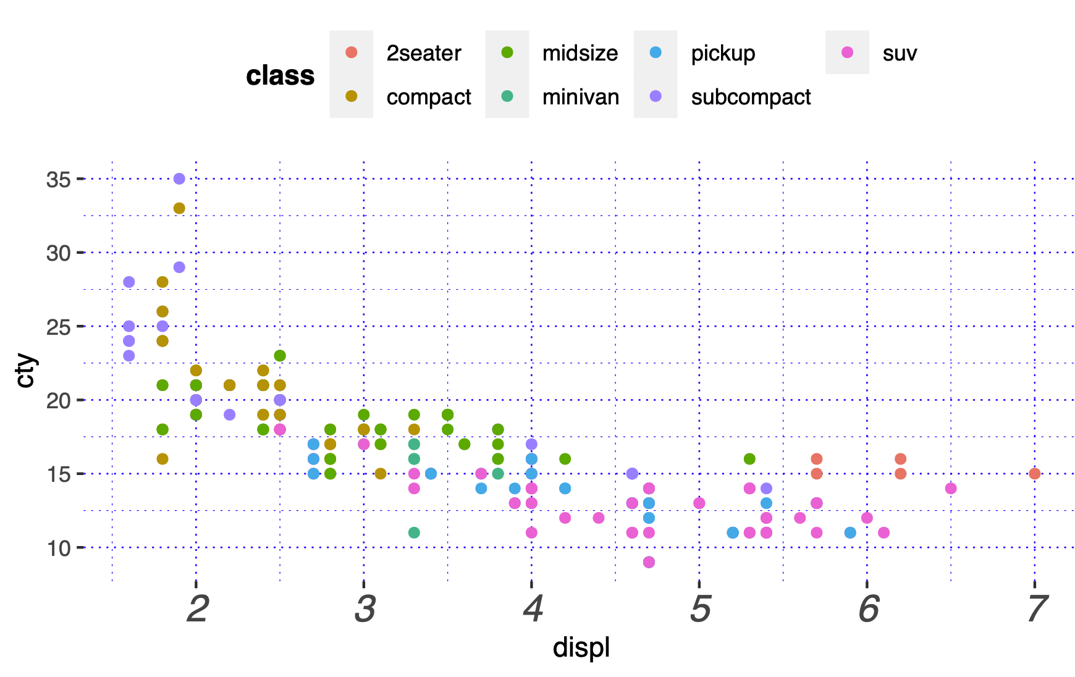

Slide 34
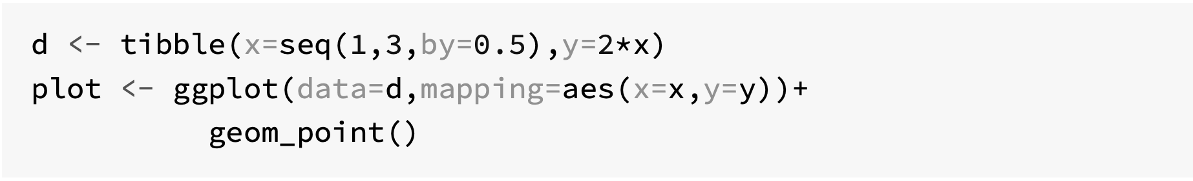
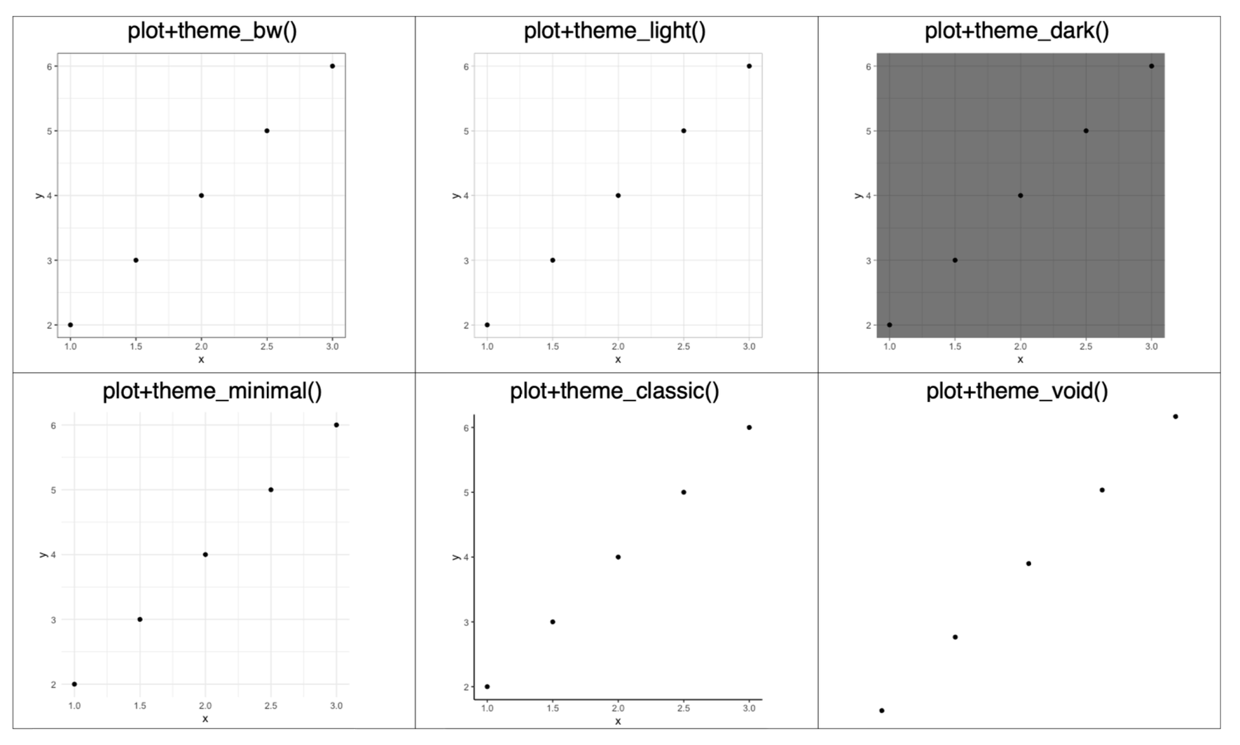
Ready to use themes

Slide 35
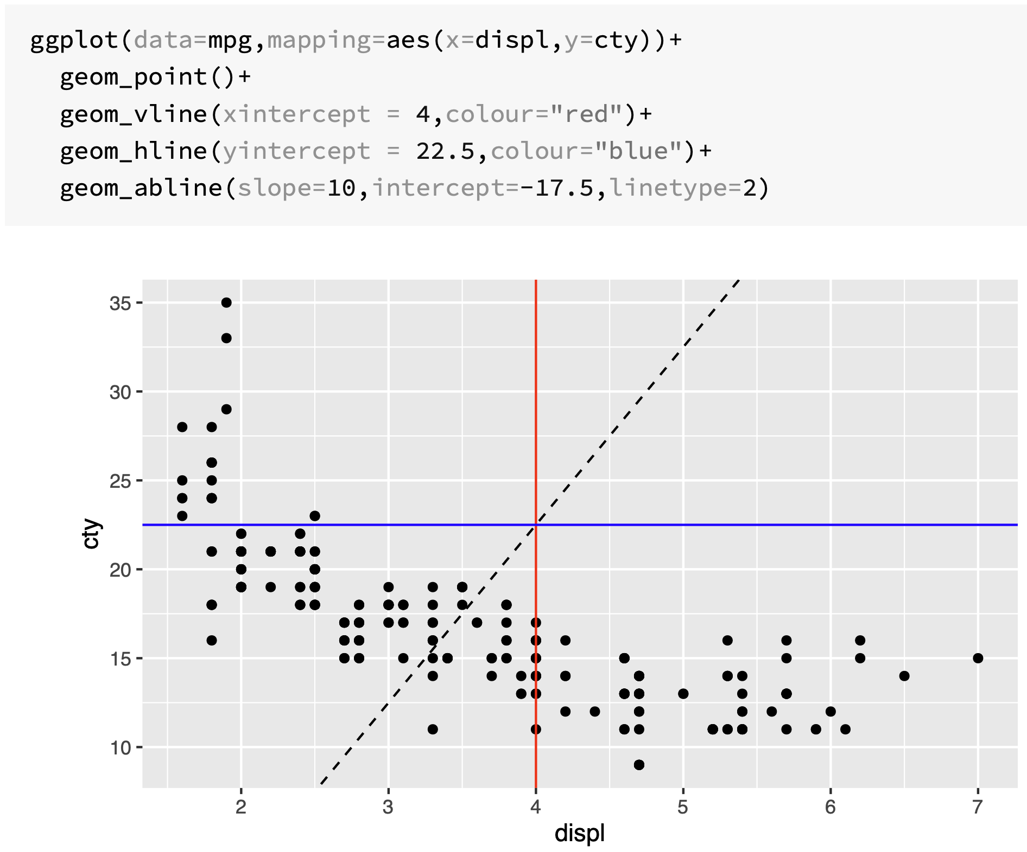

Slide 36
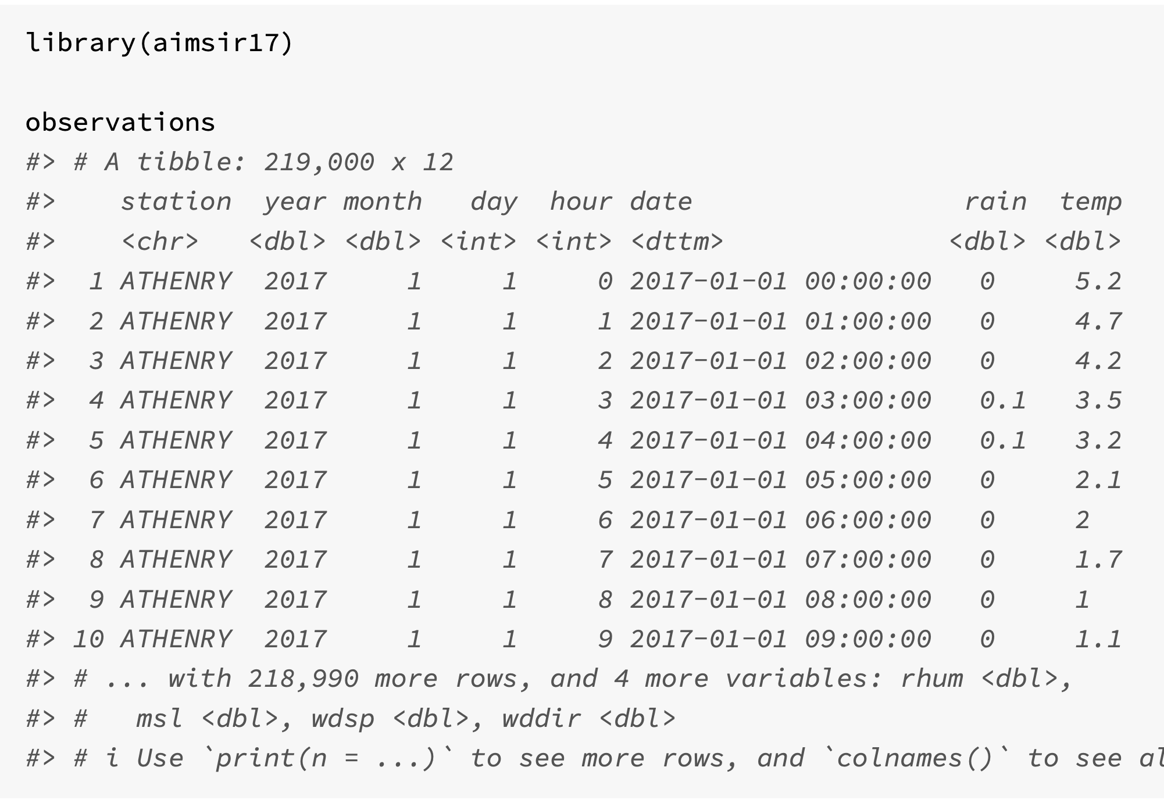
Mini case – Storm Ophelia 2017
aimsir17 package (CRAN)
219K records
Hourly observations
25 weather stations
Variables
rain
temp
rhum
msl
wdsp
wddir

Slide 37
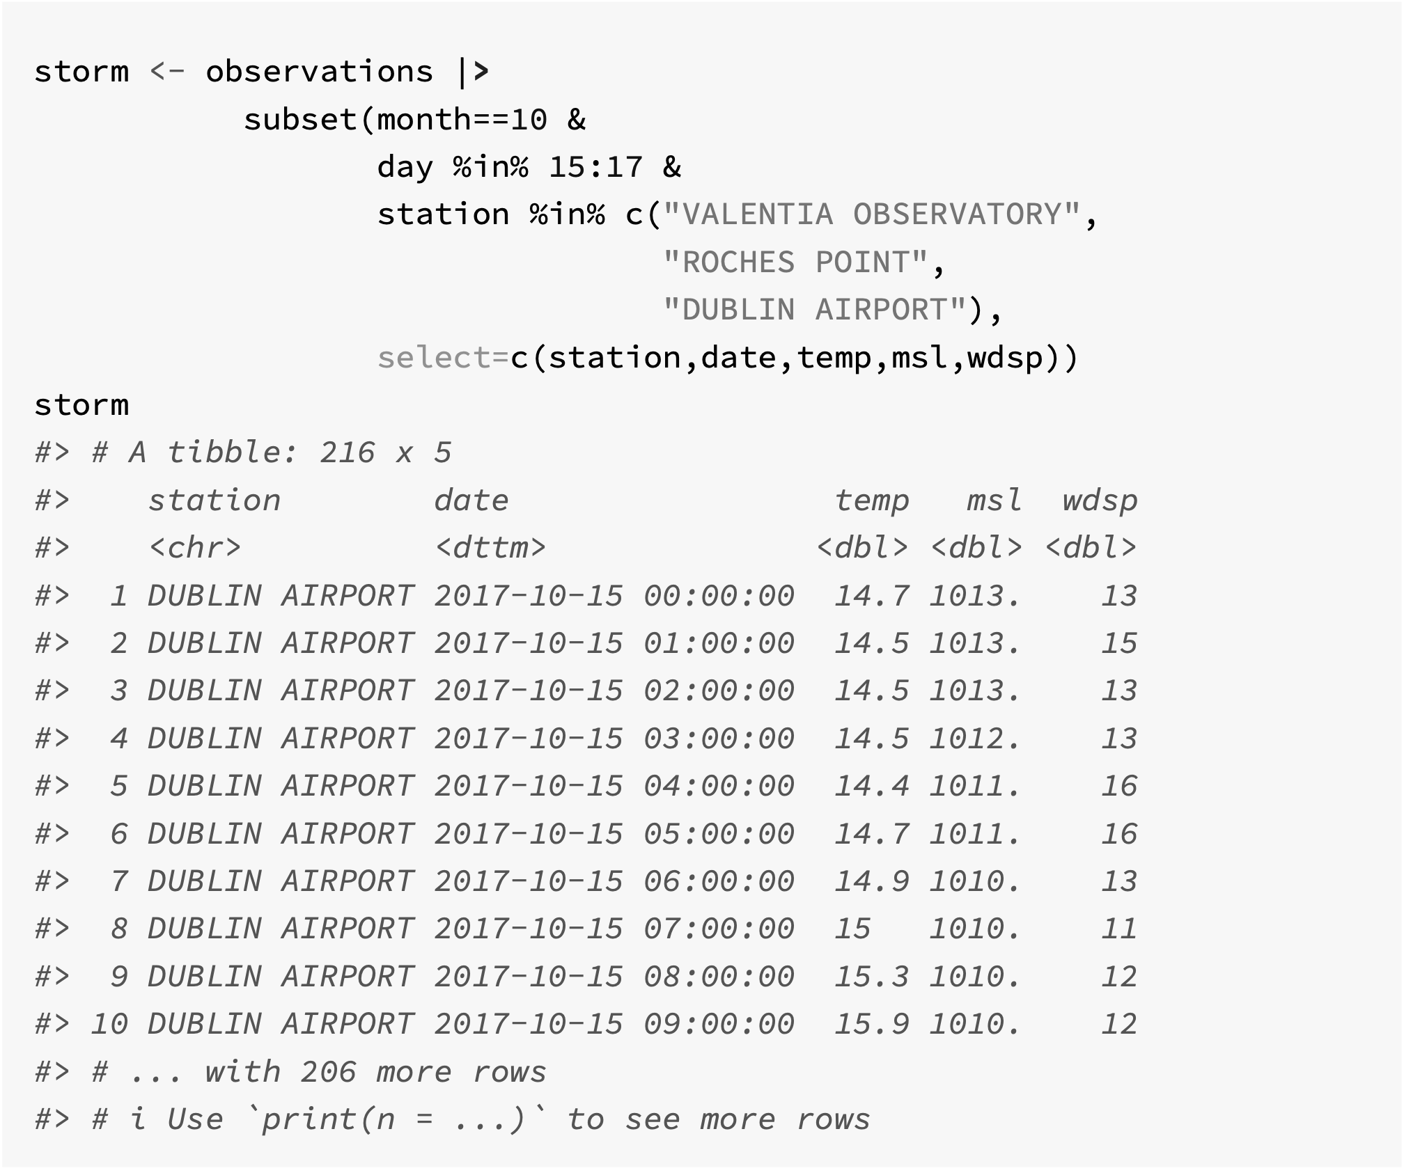

Slide 38
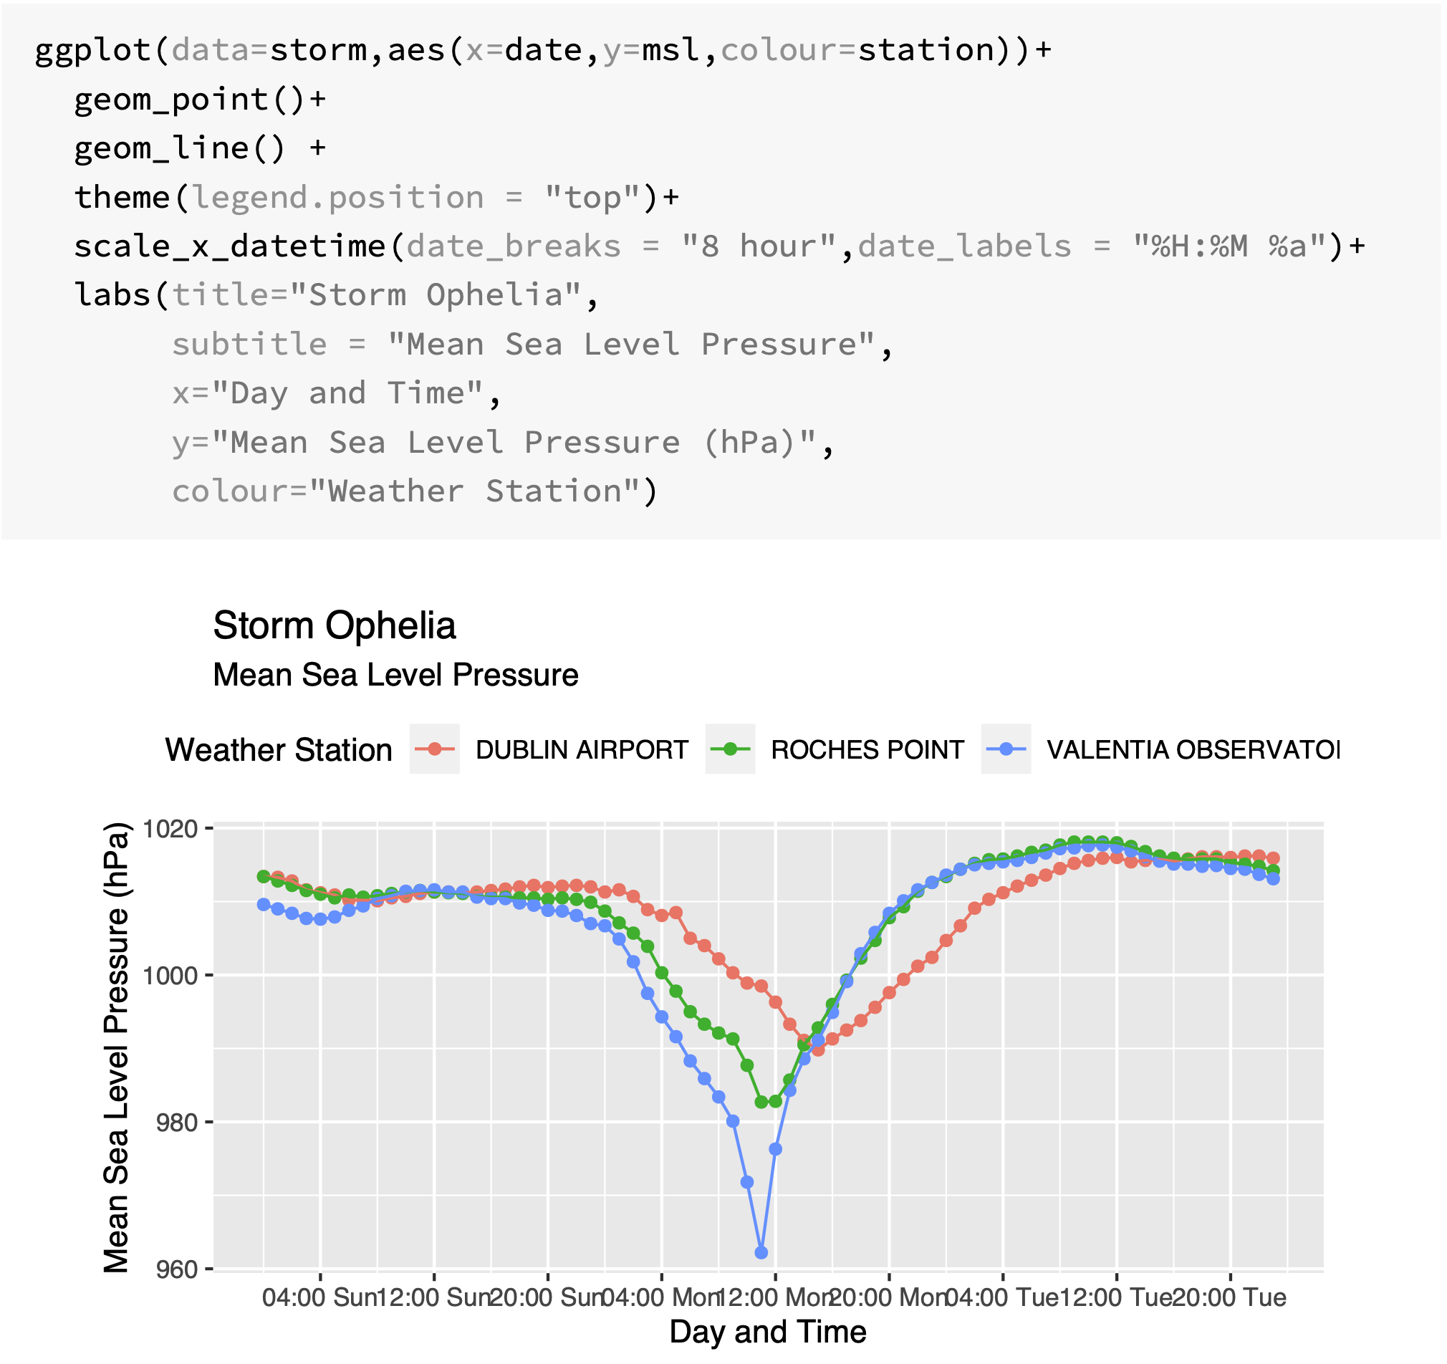

Slide 39
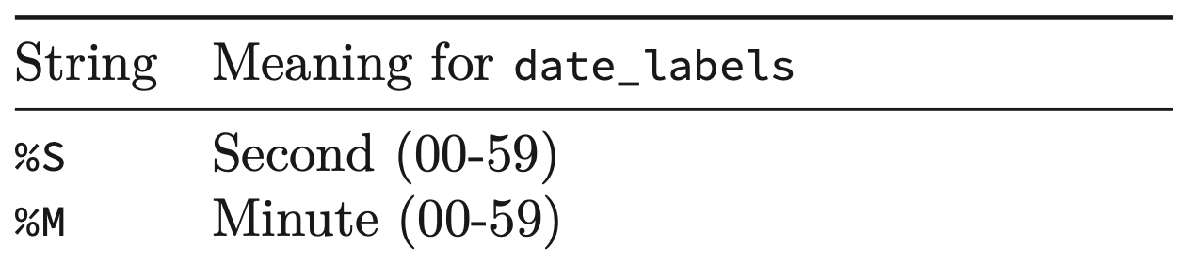
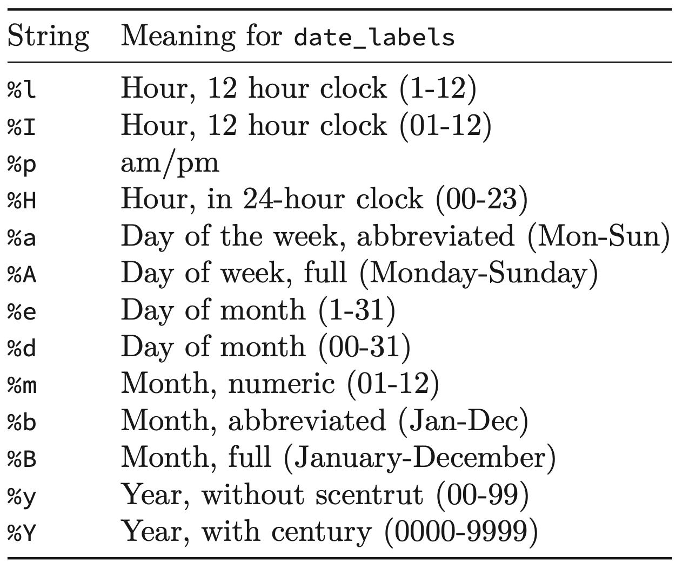
scale_x_datetime()

Slide 40
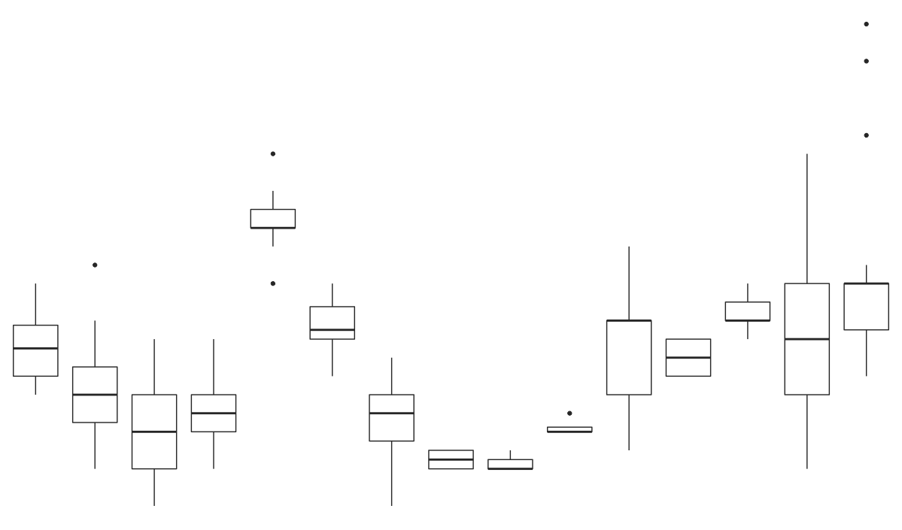
Challenge 5.3
Generate the following boxplot from mpg. The data is the same as 5.2

Slide 41
Useful geoms
Geom | Purpose
geom_smooth() | Fits a smoother to data and displays the smooth and its standard error
geom_boxplot() | Produces a box-and-whisker plot to summarise the distribution of a set of points
geom_histogram() geom_freqpoly() | Shows the distribution of continuous variables
geom_bar() | Shows the distribution of categorical variables
geom_path() geom_line() | Draws lines between data points
geom_area() | Draws an area plot, which is a line plot filled to the y-axis. Multiple groups will be stacked upon each other
geom_rect() geom_tile() geom_raster() | Draw rectangles
geom_polygon() | Draws polygons, which are filled paths.

Slide 42
Summary
Layered grammar of graphics, enables us to concisely describe the components of a graphic.
Benefits:
plots can be designed in a layered manner (+ operator)
a wide range of plots can be generated to support decision analysis, including scatterplots, histograms and time series charts
charts can be developed rapidly, and this support an iterative process of decision support

